Slide 1

Anderson County Schools Preschool Program
Effective Use of Data & Community Assessment Training
May 20, 2015
Clinton, TN
www.noloconsulting.com

Slide 2

Ice Breaker
1) What is the number of people in the US below poverty level in 2013?
  48,810,868 (15.8 percent)
2) What is the number of people in Anderson County below poverty level in 2013?
  14,600 residents living in poverty, a rate of 19.7
3) What is the Estimated Number of Children 0-4 living in poverty in Anderson County?
  1,359 children
4) What is the percentage of total households in Anderson County, TN that are renters (2008-2012)?
  In Anderson County, 31 percent of households are renters.
5) What is the FMV of a two bedroom home in Anderson County?
  The fair market value of a two-bedroom home is $774
6) How many hours per week does a minimum wage worker must work to afford a 2-bedroom home at fair market value?
  In Anderson County those earning minimum wage ($7.25/hour) have to work more than two fulltime jobs to afford a 2-bedroom home at fair market rental value, or work 82 hours per week.

Slide 3
Agenda
Welcome and Introductions
Group Activity
Training Background, Objectives and Expectations
Data-Driven Decisions, What and Why?
Approach to an Effective Community Assessment (Prezi Presentation)
Data Findings and Implications: What do we have to say and how do we tell the story of our community?
Data Team Tools: Parallel Thinking and Logic Model
Program Planning Process: Mission, Vision and Program Goals
Program Goal Setting Process
Q & A and Wrap Up

Slide 4
Training
Session
Objectives
To gain skills in collecting actionable data
To understand all the community assessment components important to Head Start
To effectively link PIR data results to strategic plans of the program
To become familiar with the implications of data findings
To help Head Start administrators improve their ability to use community assessment data to improve program marketing plans and relationships with key stakeholders

Slide 5
Background
In Head Start, there is a move towards more accountability and a push for data‐driven decision‐making.
ICF and Region IV established a Data Institute and reached over 100 grantees.
Overall purpose was to apply different data process concepts and related tools to the construction of a data action plan and to observe basic techniques of data analysis to real-life Head Start examples.

Slide 6
What we learned?
The saying that HS programs are “data rich” and “information poor,” while ironic, is often true
Programs need to move away from a unitary focus on data by a single person or division
A data-driven culture can be achieved regardless of a program’s resources, structure or size
www.noloconsulting.com

Slide 7
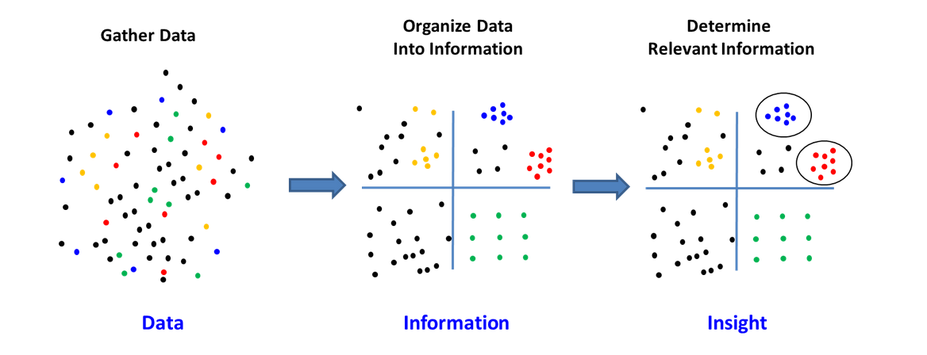

Slide 8
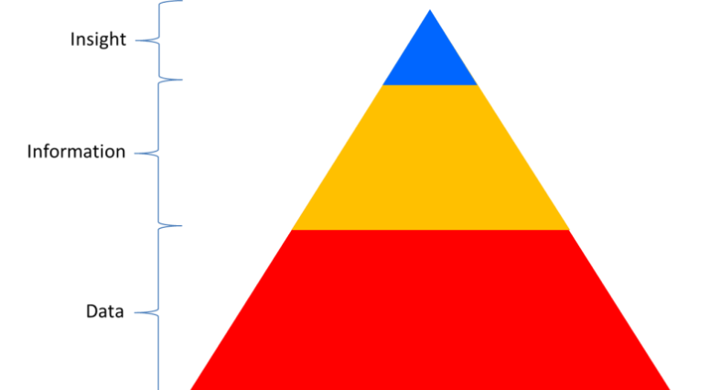
The Actionable Insight
Gather data
➔
De-duplicate and collate
➔
Refine into an action plan

Slide 9
Not Effective Use of Data
Collected data to satisfy compliance.
Data flowed upward from local program to the federal government; but it wasn’t used at the program level.
Data were not delivered to users in a timely manner, and programs did not feel comfortable with the quality of the data.

Slide 10
Effective Use of Data
Programs collect and analyze data in order to answer critical questions.
Data turnaround is fast.
Information is presented so that it can be used by staff, teachers, parents, governing bodies, and policy groups in real time.
Notes:
“Rethinking data this way, analysis is richer and programs are able to use the information they gathered from the data to set strategic directions, find systemic solutions, answer critical questions, and continually improve their services to children and families.”

Slide 11
Conditions / Elements for
Data-Driven Success
Culture (leadership)
Quality (data and information rich)
Capacity (data team and plan/process)

Slide 12
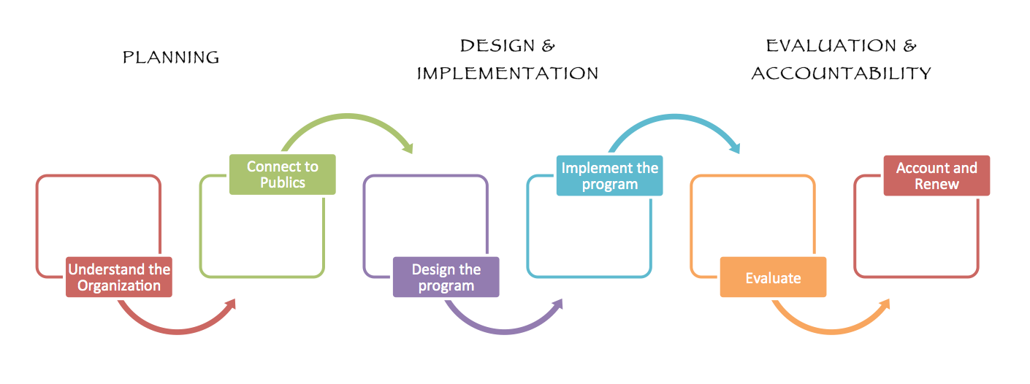

Slide 13
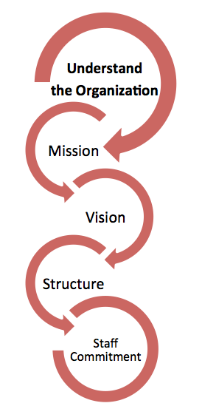
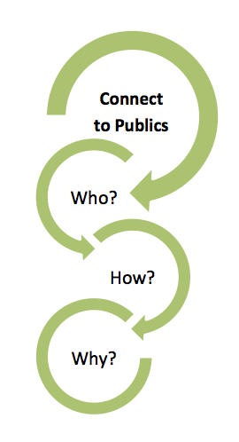
PLANNING: Understand the Organization
PLANNING: Connect to Publics

Slide 14
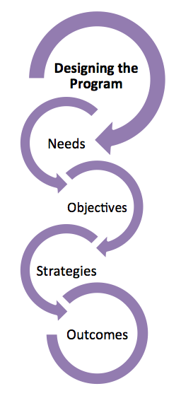
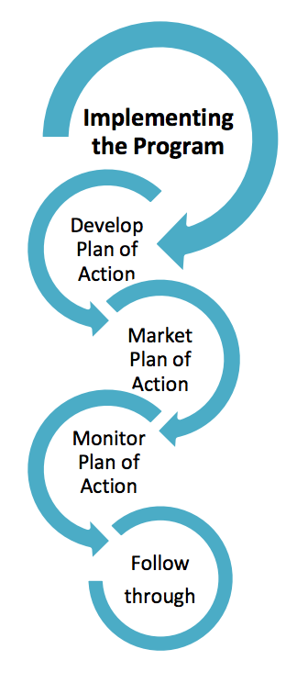
DESIGN & IMPLEMENTATION

Slide 15
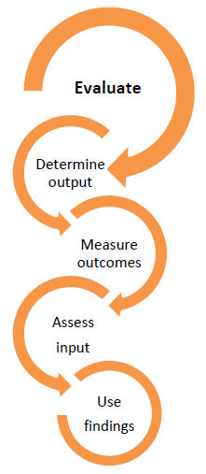
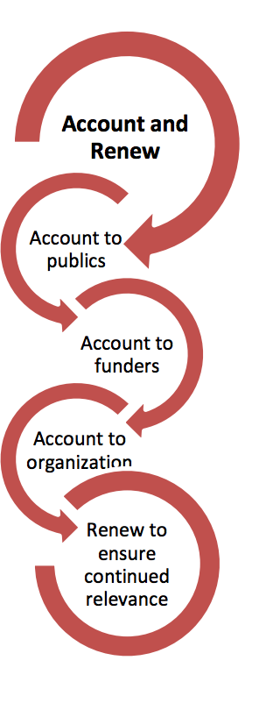
EVALUATION AND ACCOUNTABILITY

Slide 17
SWOT Matrix Evaluation
Strength GOOD NOW Maintain, Build, Leverage | Weakness BAD NOW Remedy, Stop
Opportunity GOOD FUTURE Prioritize, Optimize | Threat BAD FUTURE Counter

Slide 18
1. Logic Model (situation, input, output, outcome)
2. Six Hats: Parallel Thinking (data team approach)
Data Tools

Slide 19
Anderson County Population
At A Glance
Anderson County’s population grew by 0.5 percent from 2010 to 2013, reaching a population of more than 75,500.
The growth seen is a result of net migration of which 80 percent is domestic migration and 20 percent is international migration.
The Hispanic/Latino population is growing rapidly but remains a small percentage of the total population.
The population of Anderson County is predominantly white (92 percent).

Slide 20
Anderson County Poverty
At A Glance
Based on 2013 Small Area Income and Poverty Estimates (SAIPE), Tennessee’s poverty rate has increased to 17.8 percent in 2013, up from 15.5 percent only five years earlier in 2008.
Anderson County has more than 14,600 residents living in poverty, a rate of 19.7 percent and more than 4,600 children under the age of 18 living in poverty, a rate of 29.8 percent.
Based on 5-year estimates from the US Census Bureau, there are more than 1,300 children ages 0-4 living in poverty in Anderson County.

Slide 21
Anderson County Economy
At A Glance
The State of Tennessee has long relied on manufacturing as its primary source of economic development.
Manufacturing jobs generally paid well and often provided workers and their families with important benefits like health insurance. But Tennessee, and the rest of the country, has seen its manufacturing employment base weakening
According to the Tennessee Department of Labor & Workforce, the 2014 Anderson’s County labor force was 34,710 of with 32,560 are employed and 2,150 unemployed (6.2 percent, December 2014).
The per capita income for Anderson County based on 2013 estimates was $25,758 and the household income was $47,785.

Slide 22
Anderson County Housing
At A Glance
In Anderson County, 31 percent of households are renters. The rent affordable by a household classified as “extremely low income” is no more than $454 per month, $320 less than the fair market value of a two-bedroom home, which is $774.
For those working a full time job and earning minimum wage, the rent that is affordable is not more than $377--approximately $400 less than the fair market value of a two-bedroom home.
In Anderson County those earning minimum wage ($7.25/hour) have to work more than two fulltime jobs to afford a 2-bedroom home at fair market rental value, or work 82 hours per week.

Slide 23
Logic Model
A logic model or program matrix is a tool to evaluate the effectiveness of a program.
A graphical depiction of the logical relationships between the resources, activities, outputs and outcomes of a program.
A logic model is to assess the "if-then" (causal) relationships between the elements of the program; if the resources are available for a program, then the activities can be implemented, if the activities are implemented successfully then certain outputs and outcomes can be expected.

Slide 24
Thinking backwards to move forward
What is the current situation that we intend to impact?
What will it look like when we achieve the desired situation or outcome?
What behaviors need to change for that outcome to be achieved?
What knowledge or skills do people need before the behavior will change?
What activities need to be performed to cause the necessary learning?
What resources will be required to achieve the desired outcome?

Slide 25
Logic Model: 5 Core Components
It displays the sequence of actions that describe what the program is and will do
how investments link to results.
Inputs: resources, contributions, investments that go into the program
Outputs: activities, services, events and products that reach people who participate or who are targeted
Outcomes: results or changes for individuals, groups, communities, organizations, communities, or systems
Assumptions: the beliefs we have about the program, the people involved, and the context and the way we think the program will work
External Factors: the environment in which the program exists includes a variety of external factors that interact with and influence the program action.

Slide 26
Program Action: Logic Model
Outcomes
Activities/ Outputs
Situation
Inputs
Knowledge & Behavior
Impacts
Identify
Problem
or Need
Invest
Staff,
Volunteers,
Money,
Materials
Deliver
Products
or
Services
Change in
Program
Participants
Change to
Population
or Area
Notes:
In order to distinguish the differences between Outputs, Outcomes, and Impacts we need to understand the continuum of Program Action.
Logic model helps us figure out the results of our programs - what to measure and demonstrate our accountability.
How many people are familiar with the Logic Model? How many use the Logic Model for their Program Development?
Activities & Outputs are often listed separately in Prog. Eval. they are technically different:
Activities are what we do in research Extension Education.
Outputs are what comes out from funded activities, the products or services.
For reporting purposes there is often overlap, like in DANRIS:
Ex. classes. What we did – teach; Output: 10 classes.
Given that ANR’s mission to be an agent of change, all what we do fits in somewhere along this continuum. Often our work is focused on Outputs and Outcomes, but there is till an impact connected to our work.
In the case of a basic research project, you can take an institutional approach to the Logic Model, and think about the team effort that leads to the long-term outcomes.
Or in the case that a prog./proj. is only at the outputs stage use the logic Model to help determine what the outcomes and impacts will be. Please include in Plan.

Slide 27
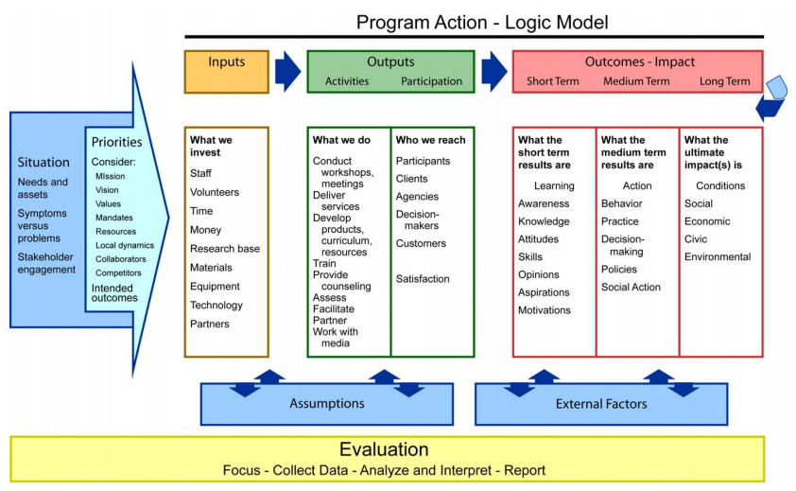

Slide 28
“Idea Killers”
Good idea, but:
  Oh, that is the same as…
  We tried that before.
  That’s not how we do it here.
  Who will pay for that?
  Management will never go for it.
Solution: Six Thinking Hats

Slide 29
Six Thinking Hats
Adversarial Thinking
A B
Parallel Thinking
A
B

Slide 30
Six Thinking Hats
Confusion is the biggest enemy of good thinking
We try to do too many things at a time
  Juggling with six balls at a time is rather difficult
  Tossing up one ball at a time is much easier
  Six Hat Thinking does one thing at a time and in the end the full picture emerges
Encourages parallel thinking
Explores a subject more thoroughly
Makes specific time and space for creative thinking
Separates ego from performance

Slide 31
WHY SIX THINKING HATS
The six hats approach to problem solving encourages thinking about data and/or planning in a creative, non-traditional manner
The hats, which are represented by different colors, can be thought of as imaginary thinking caps.
The hats focus the discussion and limit the risk of wasting time with off-topic discussions, arguing and wheel spinning, because one of the goals of six thinking hats is to use meeting time productively, it can be a very useful tool.

Slide 32
SIX THINKING HATS: instructions and steps
Steps of the process: Share a situation, question, idea, problem or a data finding that you want the team to think about and/or strategize in the planning process.
The team members will discuss data and/or the topics in 10 minutes intervals under a specific hat.
  Have one person collect the data ideas provided or use a Post It Easel Pad to easily jot down information in a way that's visible to a whole room.
After 10 minutes make the participants change the hat. Alternatively at this point you can have a brief summary session of the discussion before changing hats.

Slide 33






Six Thinking Hats – Data Team Process
White Hat: Looks objectively at data and information. Is neutral and concerned with facts and figures.
Red Hat: Legitimizes feelings and gives an emotional view, hunches, and intuition.
Yellow Hat: Is positive and constructive. The yellow color symbolizes sunshine, brightness and optimism.
Black Hat: Is logical, negative, judgmental, and cautious. Is gloomy, suggests why it cannot be done.
Green Hat: Is about new ideas and creative thinking.
Blue Hat: Controls the thinking process. The blue hat is concerned with control and the organization of the thinking process.

Slide 34

blue hat
Where should we start?
What is the agenda?
What are the objectives?
Which hats should we use?
How can we summarize?
What should we do next?

Slide 35

white hat
What information is available?
What information do we need?
How are we going to get the missing
information?

Slide 36
red hat
What are my feelings right now?
What does my intuition tell me?
What is my gut reaction?

Slide 37
black hat
What are some possible problems?
What difficulties could we encounter?
What are points for caution?
What are the risks?

Slide 38

yellow hat
What are the benefits?
What are the positives?
What are the values?
Can this be made to work?

Slide 39

green hat
What creative ideas do we have?
What are the alternatives?
How can we overcome the black hat difficulties?

Slide 40
Program Goals

Slide 41
Goal setting
Broad goals based on data from community assessment, Self-Assessment, and ongoing monitoring
Overarching goals (such as developing an attendance campaign or a healthy living initiative) that, to be achieved, require contributions from all parts of the program
Program goals related to family outcomes
are broad statements that describe what a program intends to accomplish in its work with (and in support of) families.
An objective is an element of a goal. It describes, in a SMART way (Specific, Measurable, Attainable, Realistic, and Timely), what the program is intending to do to reach the goal.
Setting BROAD goals (Bold—Beyond expectations, Responsive, Organization-wide, Aspirational, and Dynamic) and SMART objectives.

Slide 42
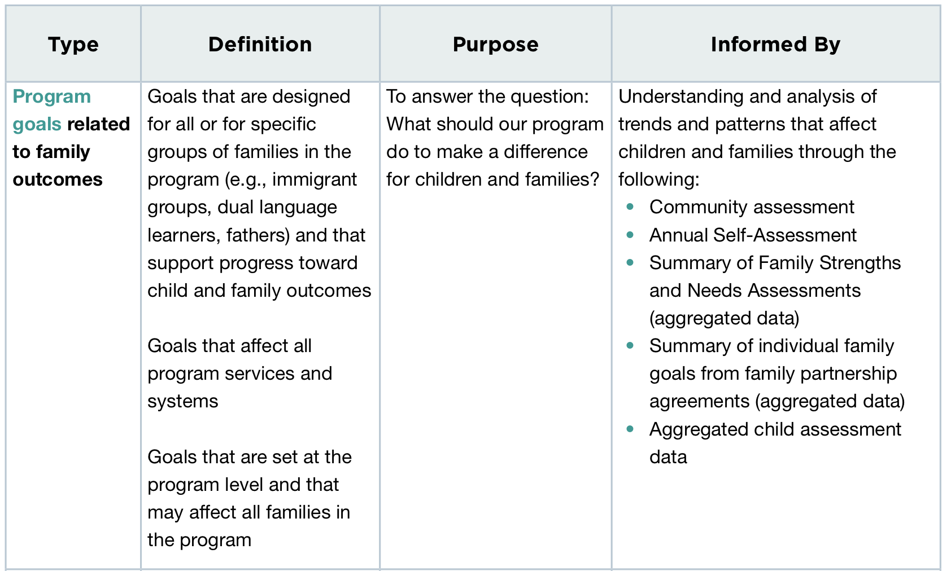

Slide 43
CHECKLIST Questions to set up strong Program Goals
Do program goals give voice to the shared vision within your program and help everyone?
Does it goes beyond current expectations?
Is it Organization-wide?
Is it supported or based on a current Community Assessment and Self-Assessment data?
Does it reflect where the program wants to be 5 years from now?
Does it address legacy expectations to the children, families, and the communities you serve?
Does it include “innovation” in addition to “compliance”?
Does not only meet the Head Start Program Performance Standards but strengthen services for children and families?
Does it motivate by engaging emotions?

Slide 44
EXAMPLE 1 OF A PROGRAM GOAL
Program Goal: “Name” Head Start Program will raise awareness and support the implementation of “attendance matters culture” and engage children, families, schools, and the entire community.
Objectives: “Name” Head Start Program will monitor attendance data regularly [weekly] to identify students who are absent 10 percent of the time, and provide the families early intervention and increase parental awareness about the importance of school attendance, arriving on-time, and the resources/supports available.
Outcome: Create a positive center climate, increase engagement with children and families through family involvement; create a culturally responsive environment; educate parents about the risk factors of absenteeism, and support school readiness.

Slide 45
EXAMPLE 2 OF A PROGRAM GOAL
Program Goal: ABC Head Start will run a state of the art technology system with networks that give access to information and applications that are appropriate for an organization with a mission to empower individual and improve communities.
Objective: ABC Head Start will install high-speed Internet at all centers, upgrade telephone communication systems and provide teachers with communication training and tools to enhance their ability to conduct virtual educational conferences with educators, colleagues and parents by the end of 2015.
Outcome: Well-thought-out technology plans can lead to greater productivity, increased staff morale, and improved service to families, community partners and children.

Slide 46
EXAMPLE 3 OF A PROGRAM GOAL
Program Goal: “Name” Head Start Program will be recognized as the most accessible and effective Early Childhood Education agency connecting parents and “most at need” communities with information on quality and comprehensive services offered to young families in the county.
Objectives: “Name” Head Start Program will lead a collaboration with Public School District and Health Department leadership and organize three events (Spring, Summer and Fall) to promote registration and health clinic open house at Head Start locations across the county.
Outcomes: Increase knowledge of parents and most at need communities about access to health services and empower parents to enroll children early childhood programs that satisfy their educational and developmental needs.

Slide 47
Durham Head Start Program Goals
Program Goal 1: Durham County Head Start Program will raise awareness and establish a “Parents as First Teachers” culture among diverse communities in the county and prepare families to foster reading and learning together.
Program Goal 2: Durham Head Start will be recognized as Durham County’s champion for fostering community collaborations that enhance and support health and nutrition services while actively engaging community leaders, community services, advocates and families.

Slide 48
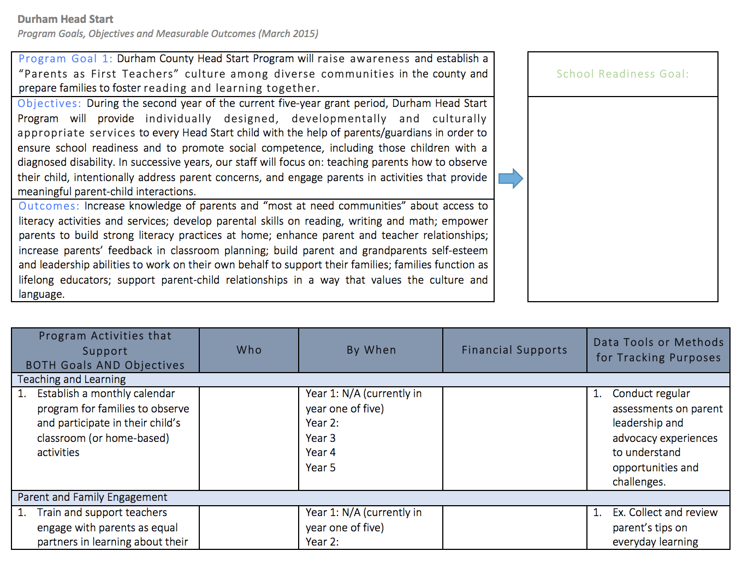

Slide 49
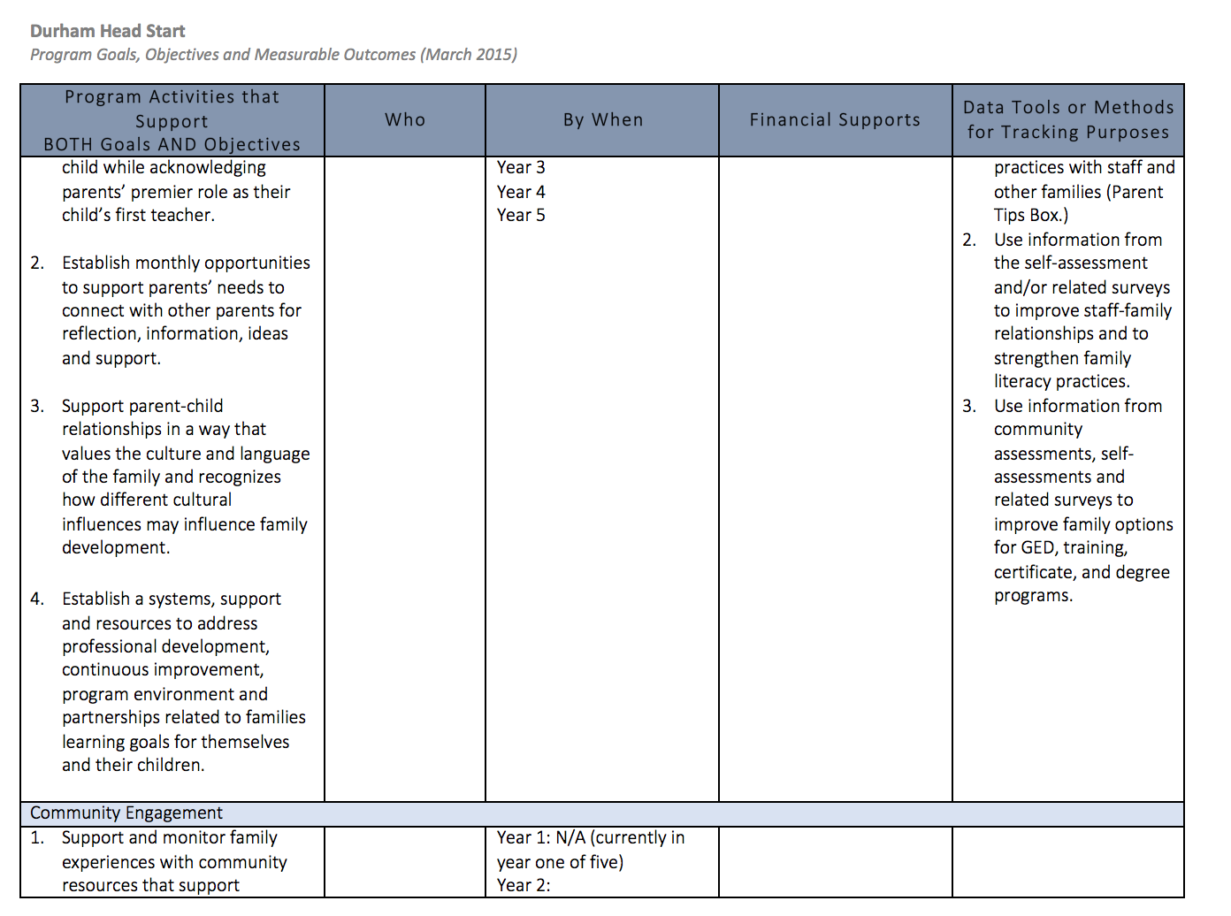

Slide 50
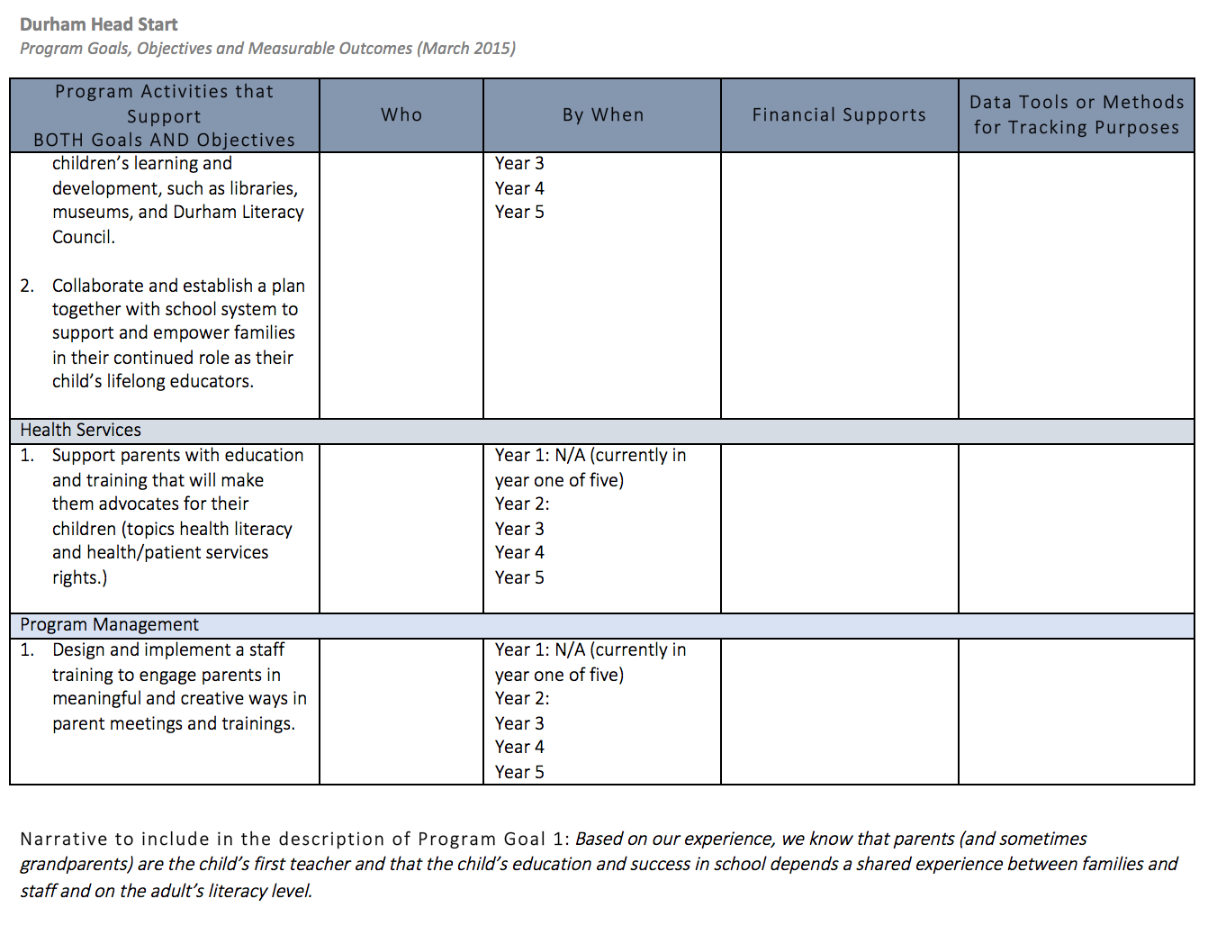

Slide 51
Questions and Answers

